Slide 1


CUI
Enlisted Promotions System Overview
SGM Lapoint
CUI

Slide 2

CUI
PROMOTION BOARD REQUIREMENTS
CUI

Slide 3
CUI
Promotion Board Requirements
PROMOTION BOARD CONSIDERATION REQUIEMENTS TO THE RANK OF:
Rank | TIG | TIS | CES | PME
SGT | 12 months | N/A | N/A | N/A
SSG | 18 months | N/A | N/A | BLC
SFC | 36 months | 8 years | 6 years | ALC
MSG | 36 months | 12 years | 8 years | SLC
SGM | 36 months | 16 years | 10 years | MLC
CUI

Slide 4
Soldier Responsibilities
CUI
Individual Soldier (E6-E8): NCOs must review their iPERMS performance folder and the Selection Board ERB with their unit Readiness/Administrative NCO before signing their TY26 Automated Promotion Board Checklist. All NCOs should ensure that they validate the ERB as part of the review process of their ERB. ERBs can be reviewed and validated by each Soldier at the following link: https://arngg1.ngb.army.mil/SelfService/CareerCenter/Home.aspx.
NCOs must verify all supporting documentation is in iPERMS. All NCOERs must be loaded into iPERMS by the admin cutoff dates. Missing NCOERs affect board ratings. The board will not accept draft evaluations.
All Soldiers are highly encouraged to write a letter to the President of the Board to clarify or explain any discrepancy in their records (e.g., missing NCOER, with an examiner, ERB errors, etc.). A missing NCOER without a discrepancy letter will negatively impact board ratings.
CUI

Slide 5
Promotion Board Checklist
CUI
Soldiers will be promoted into assignments based on the option selected on the TY25 Promotion Board Checklist.
Option 1 = promotion only in my assigned unit
Option 2 = promotion only in my current battalion (includes Option 1)
Option 3 = promotion in any unit within 50 miles of the home of record (includes Option 1 & 2)
Option 4 = promotion in any unit in the state
Option 5 = I wish not to be considered for promotion during this cycle. All Soldiers that select this option must submit a DA Form 4187 using the sample in enclosure 3 with the checklist.
CUI
Notes:
NOTE: AGRs will default to option 4 regardless of the preferred selection. Only RRB AGR Soldiers can select option 2 to allow stability within recruiting or option 4 to compete with others in their CPMOS provided they are out of their 18-month AGR stabilization period for their initial AGR tour.

Slide 6
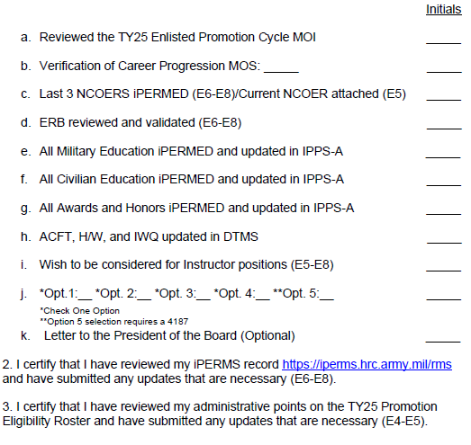
Promotion Board Checklist
CUI
CUI
Notes:
NOTE: AGRs will default to option 4 regardless of the preferred selection. Only RRB AGR Soldiers can select option 2 to allow stability within recruiting or option 4 to compete with others in their CPMOS provided they are out of their 18-month AGR stabilization period for their initial AGR tour.

Slide 7
Centralized Promotion Board Process
CUI
Each NCO is individually evaluated by five board members.
The voting process consists of a hard vote and a soft vote.
The NJARNG established a minimum hard vote promotion point score of 38 points IAW AR 600-8-19, 6-2(k). NCOs who fall below the minimum promotion board score will not appear on the promotion list and will receive a MFR from the State Command Sergeant Major. The G1 will add MFR to the Soldier’s iPERMS in the performance folder.
CUI

Slide 8
HARD VOTE
CUI
This vote consists of the review of the Soldier’s last 3 NCOERs
It is broken down between each categories of the NCOER:
  Attributes
  Competencies
  Performance
  Potential
CUI

Slide 9
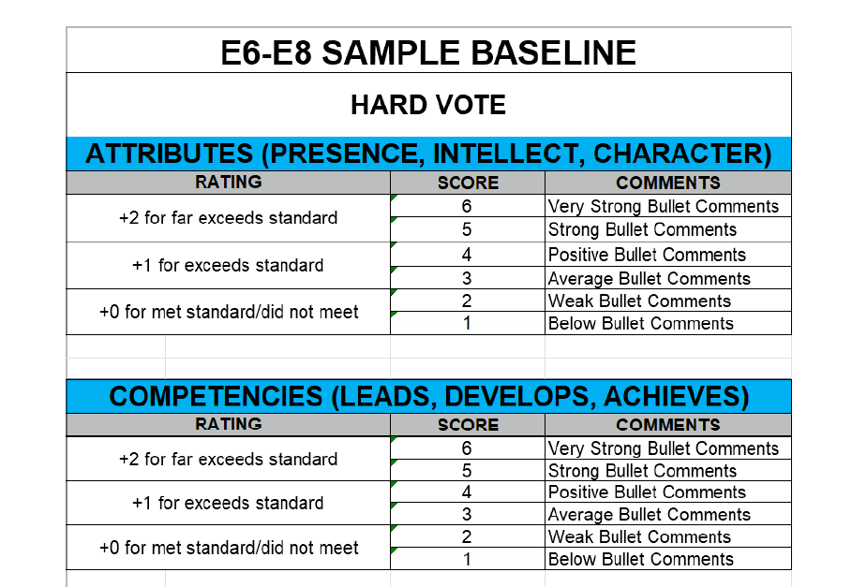
HARD VOTE
CUI
CUI

Slide 10
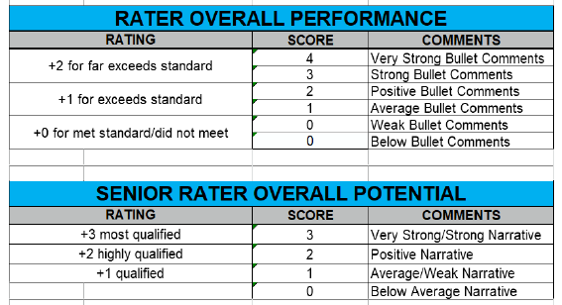
HARD VOTE
CUI
CUI

Slide 11
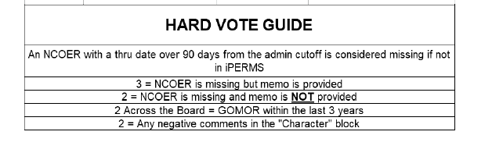
HARD VOTE
CUI
CUI

Slide 12
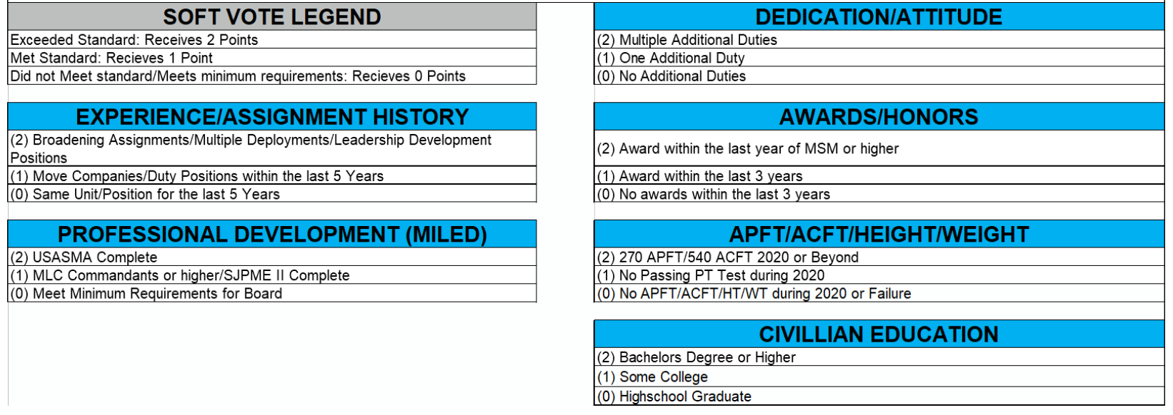
Soft Vote
CUI
CUI

Slide 13
Promotion Eligibility
CUI
ALL Soldiers must be current on ACFT, HT/WT PHA and service obligation.
Current Army Combat Fitness Test requirement, must have a valid passing (ACFT) within the last 8 months for AGR and within the last 14 months for TDG.
Current Height & Weight requirement: have a passing (HT&WT) within 8 months for both AGR and TDG.
Current Physical Health Assessment (PHA) within 15 months and not coded MRC 4.
Service obligation for grade E1 to E6. NONE.
Service obligation for E7 and above is (3yrs).
Soldier must have the appropriate security clearance for their MOS and rank and have NO FLAGS.
CUI

Slide 14
Top Metrics
CUI
Received an award or coin
Recognition as NCO or 1SG of the Year
Served in a leadership role
Commandant's List or Honor Graduate
Volunteer for community support
Additional duties (MRT, UVA, EO)
Senior rater comments promote immediately
CUI

Slide 15
CUI
QUESTIONS?
CUI

