Slide 1
TALENT MANAGEMENT
WWW.STATECSMNJ.ORG
Notes:
Welcome
How does promotion system work?
What do you need to do to get promoted? This has been a question I repeatedly get asked.
This is what we will discuss today.
Agenda – talent Management – current system- proposed system - NCOERS
All briefs will be posted on SCSM website website

Slide 2
https://www.army.mil/g-1#org-g-1-publications
Notes:
Army G1 webpage provides the NCO Development guide DA PAM 600-25
NOT a path of assignments and education that guarantees promotion
However it does describe the full spectrum of developmental opportunities

Slide 3
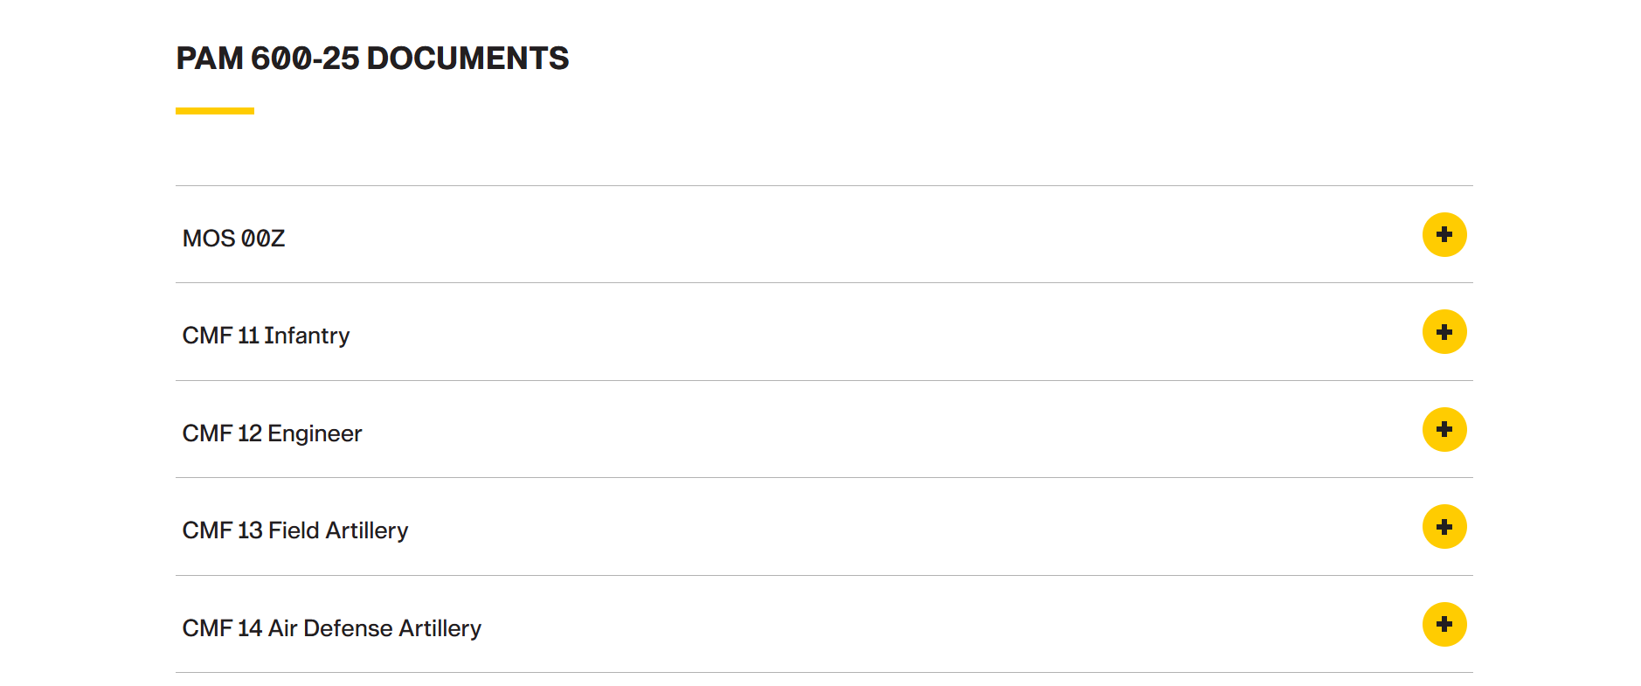
Notes:
Scroll through this and by your branch you can read Army guidance for your career management field

Slide 4
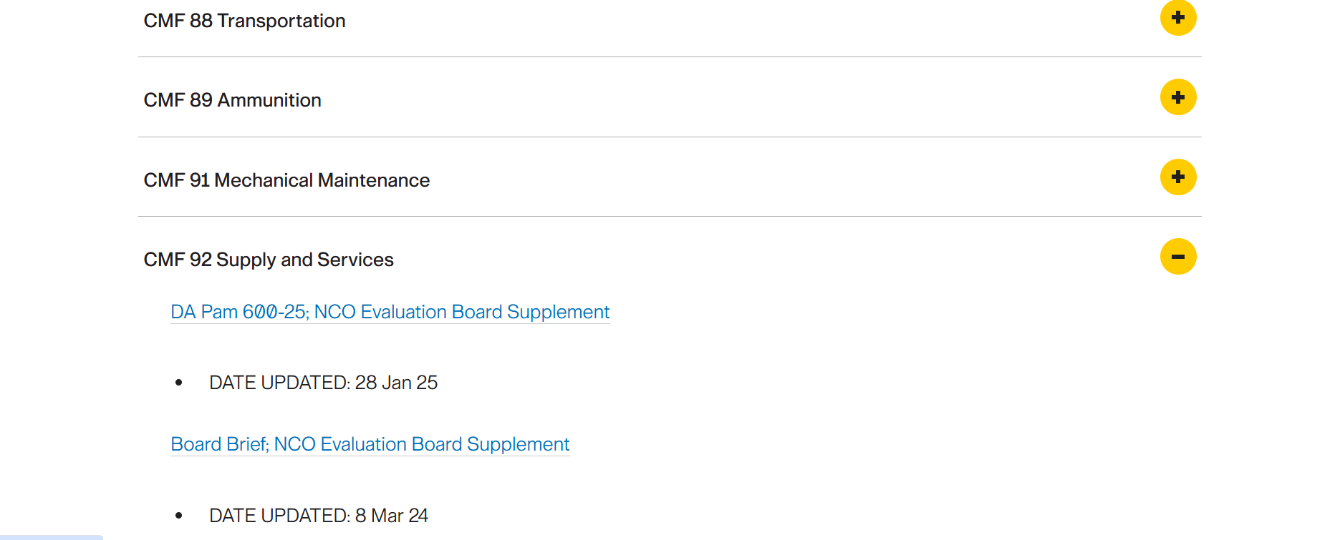
Notes:
For example today we will look at Career Management Field 92 Supply and Service
Click on the yellow plus sign on the right and it opens up two drop downs for evaluation board supplements
This is the most up to date criteria the ARMY G1 provides promotion boards
First we will look at board brief

Slide 5
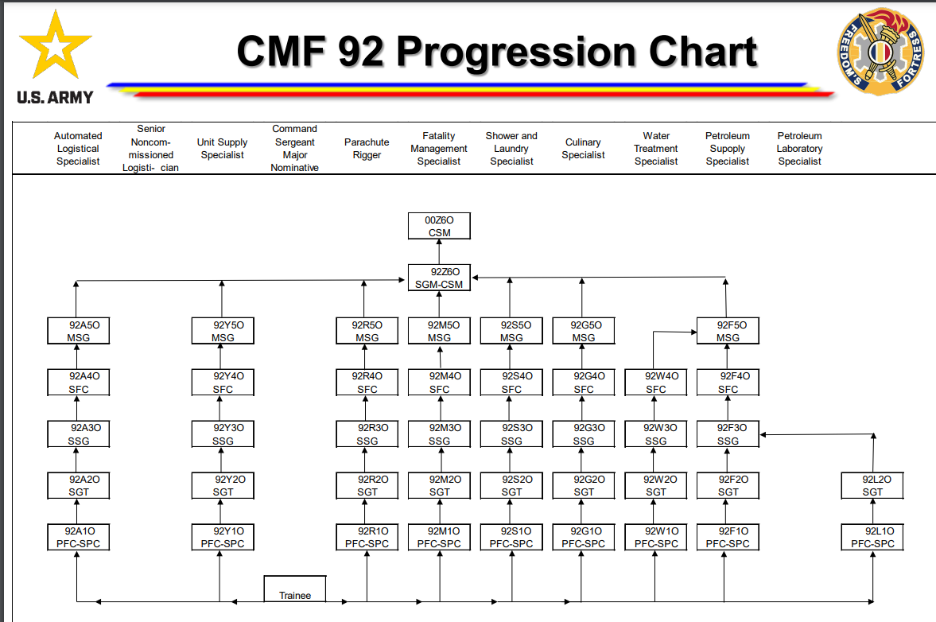
Notes:
First you will see the different MOS’s within the 92 series and how you can advance from private up to CSM

Slide 6
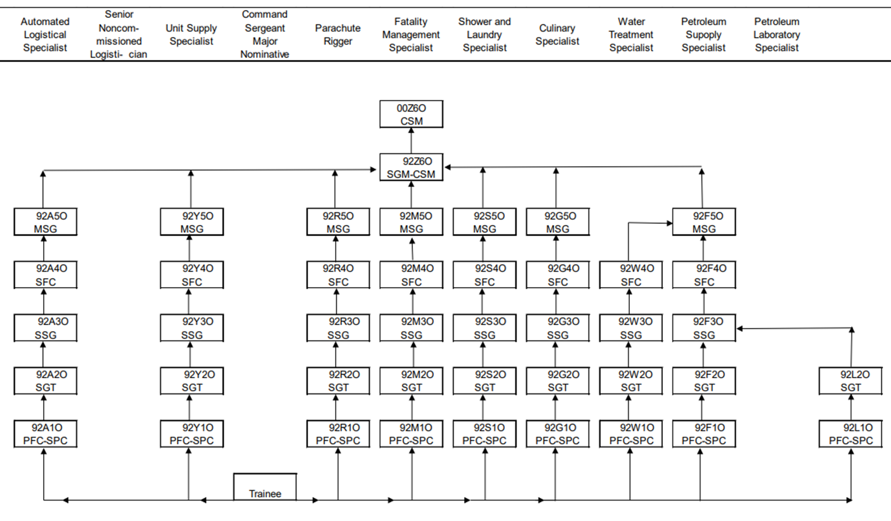
Notes:
Better view
There is a chart like this for every career management field
For this brief I’m just focusing on the 92 series

Slide 7
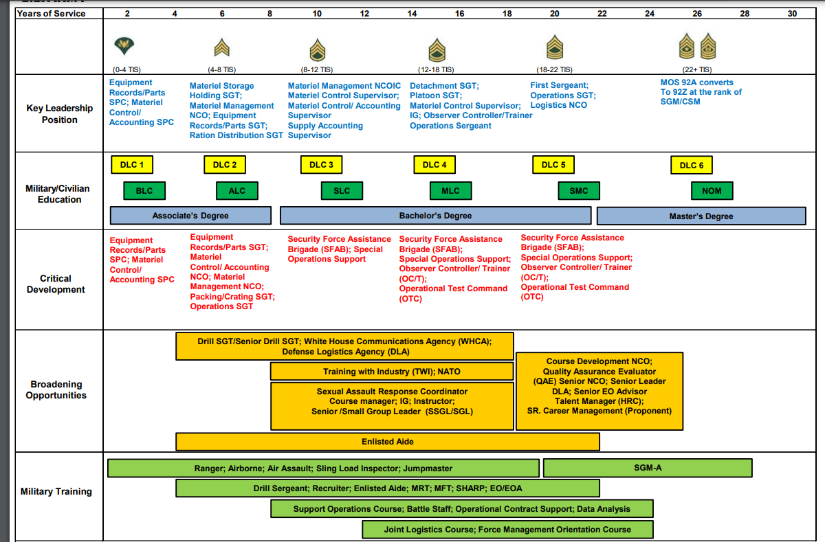
Notes:
Then you will come to a chart that suggests what you should focus on at each rank in the 92 series in regards to:
Leadership positions,
Military and civilian education
Critical development,
Broadening opportunities
Military training.
I will break up talking about this in two slides

Slide 8
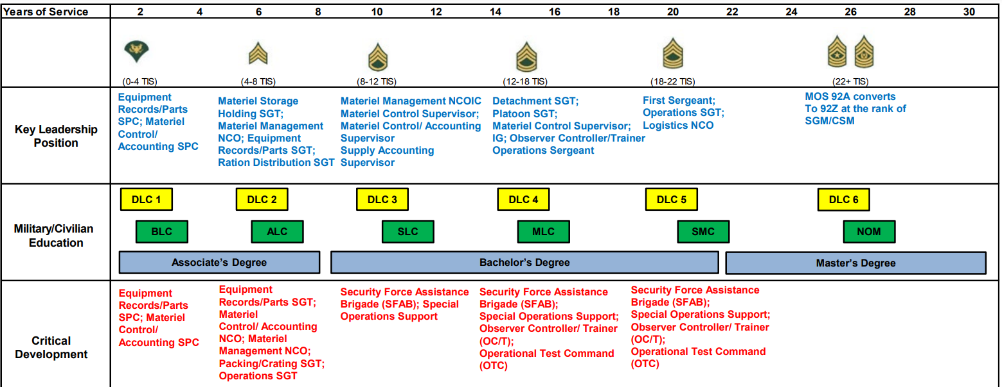
Notes:
Although this is the most updated information from the ARMY G1 something still need updating
Under education distance learning is no longer necessary
it also suggests being proactive and not waiting till you need the class for promotion. For example BLC is not required until you are trying to make E6
Notice the key leadership positions recommended
There is a chart like this for every career management field
Civilian education is emphasized
Security Force assistance Brigade or Observer Controller /Trainer is emphasized. We have OCT in NJ but not the SFAB

Slide 9
Notes:
Broadening opportunities – we have many of these in NJ – Drill sergeant, SARC, IG, Instructor,
Military training – NJ is not going to send you to Airborne school but Master resilience, Master fitness, SHARP, EO, Battle Staff are just some of the functional schools availablethese are available

Slide 10
cmf-92-da-pam-600-25-28-jan-25.pdf
Notes:
The previous slides are just a visual overview
If you read DA PAM 600-25 for whatever branch and rank you are interested in it describes in clearer detail than the past slides what you need to do to be most qualified in your branch at your current rank
So for those of you asking what should I be doing this is where you look.
This is ARMY doctrine not NJ SCSM Leonard doctrine.
Now Soldiers are asking how does this directly relate to how New Jersey does promotion boards? For that G1 SGM Lapoint will explain the current promotion system.

